Slide 1

Knowledge Transfer for Mocha, Chai & Sinon

Slide 2
Agenda
Introduction
Features
Installing
Code Examples
Hooks
Exclusive Tests
Similar Testing Framework
Introduction
TDD
BDD
Installing
Interfaces
Code Examples
Introduction
Installing
Test Doubles
Fake
Stub
Spy
Mock

Slide 3
Introduction about Mocha
- Mocha is a feature-rich JavaScript test framework running on Node.js.
Official Documentation Link
- Mocha's API Documentation
- Get started with Mocha testing
- A quick and complete guide to Mocha testing

Slide 4
Mocha’s Features
- Runs on Node.js/Browser
- Supports BDD/TDD
- Choose any assertion library (such as chai)
- Choose any mocking library
- Async and promise support
- Tests match a regexp

Slide 5
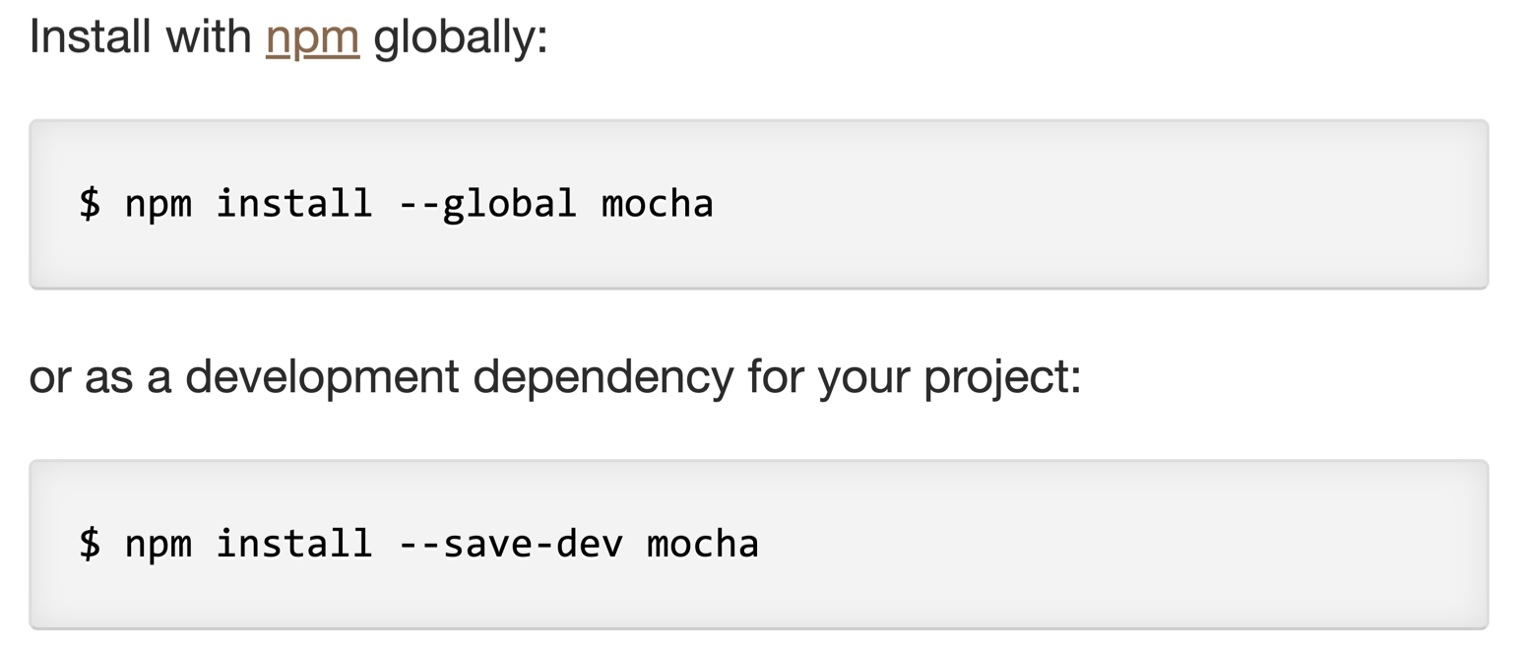
Installing Mocha

Slide 6
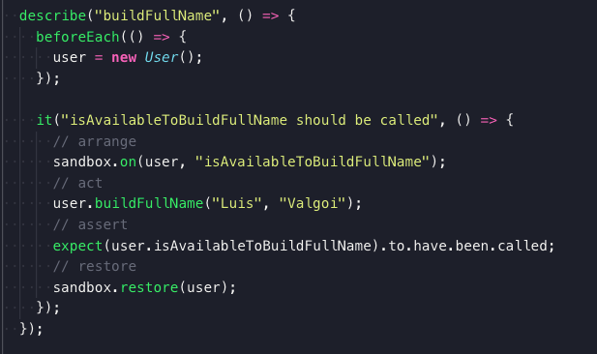
Test Structure
test suite
test fixtures / hooks
test case
arrange
act
assert

Slide 7
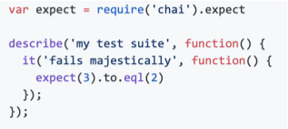
Code Example

Slide 8
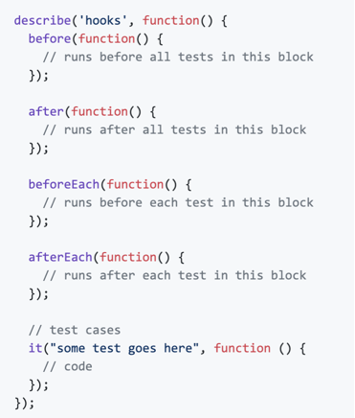
Hooooooooooks

Slide 9
Hooooooooooks

Slide 10
Hooooooooooks

Slide 11
Hooooooooooks

Slide 12
Exclusive Tests

Slide 13
Exclusive Tests

Slide 14
Exclusive Tests

Slide 15
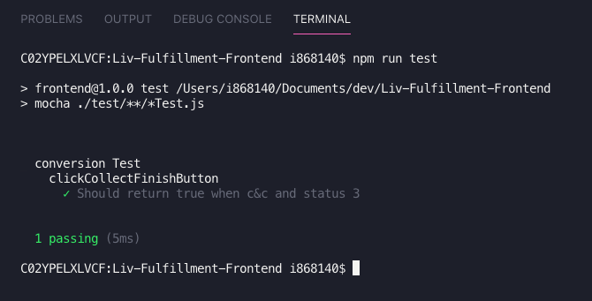
Exclusive Tests

Slide 16
Mocha’s similar testing framework
ability to write BDD
highly integrated w/ nodejs
easy async tests
easy to start
test order suite execution
hard async tests
BDD Focused
user friendly syntax
easy async tests

Slide 17
Knowledge Transfer for Mocha, Chai & Sinon

Slide 18
Introduction about Chai
- TDD / BDD assertion library for node.
TDD / BDD
- Provides expect(), should(), expect() interfaces to better assertion.
- Official Documentation Link
- JavaScript unit testing tools Cheat Sheet
- The Ultimate Unit Testing Cheat-sheet
- Language Chains from Aaron

Slide 19
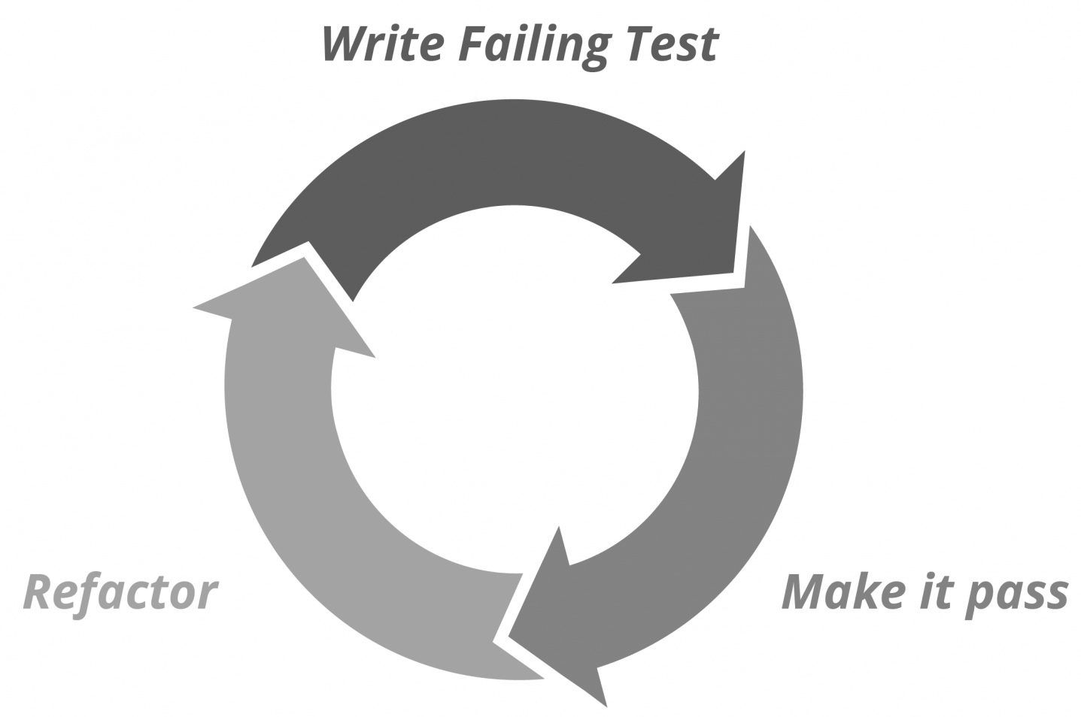
TDD / BDD
- Stands for: Test Driven Development
- Different than "Write all your tests". It's a cycle.
- Rules (RED, GREEN, BLUE):
- First you test you UC
- Second you implement you UC
- Then refactor your code

Slide 20

TDD / BDD
- Stands for: Behavior Driven Development
- BDD comes from TDD
- TDD was to hard to explain
- It’s a simpler way to write tests
"Don't write a test, describe a behavior"

Slide 21
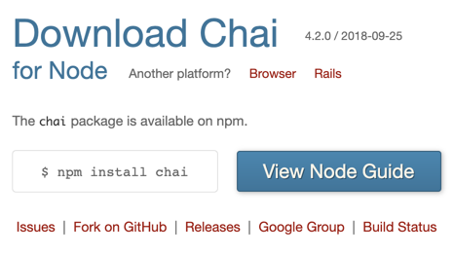
Installing Chai

Slide 22
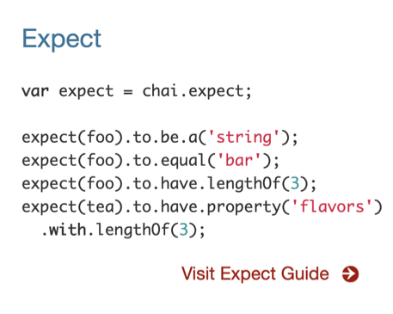
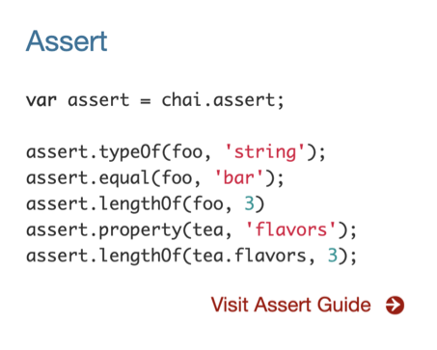
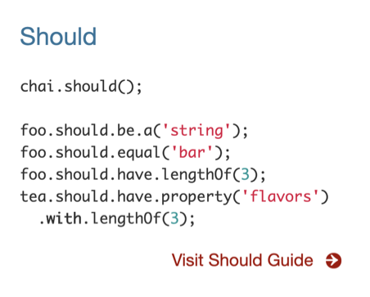
Chai’s Interface

Slide 23
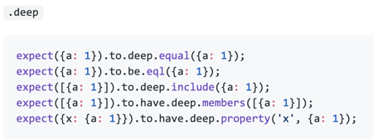
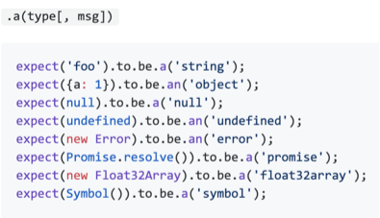
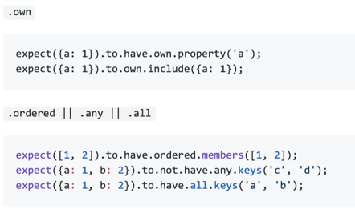
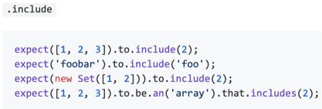
Chai’s Interface

Slide 24
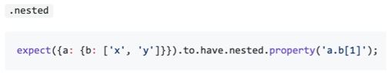
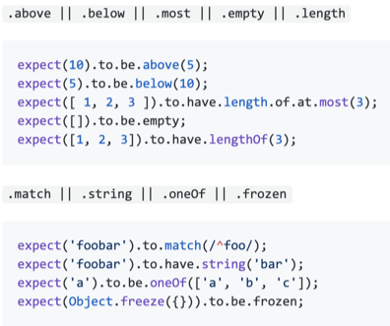
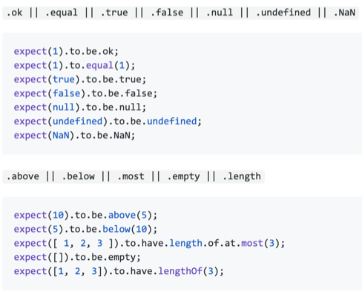
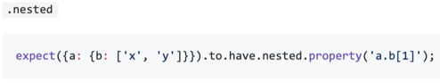
Chai’s Interface

Slide 25
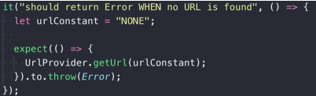
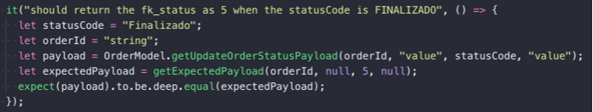
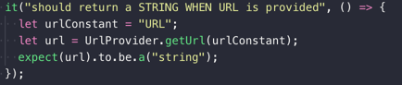
Code Examples

Slide 26
Knowledge Transfer for Mocha, Chai & Sinon

Slide 27
Introduction about Sinon
- Standalone test spies, stubs and mocks for JavaScript.
- Works with any unit testing framework.
- Official Documentation Link

Slide 28
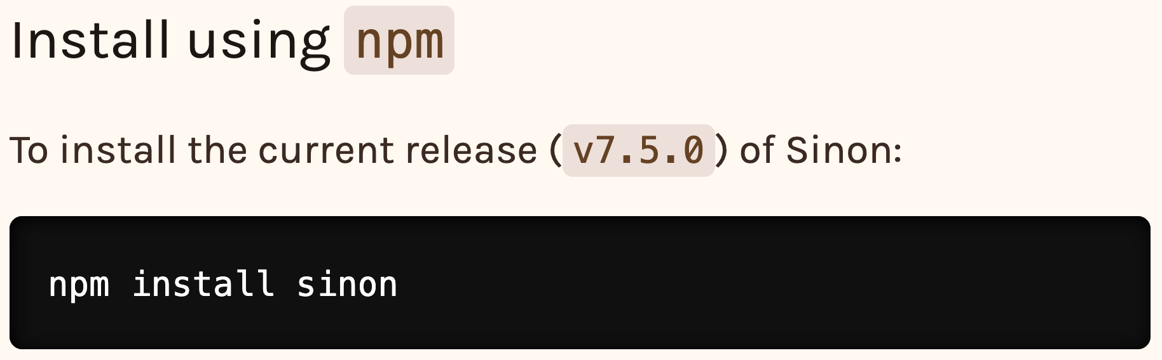
Installing Chai

Slide 29

Test Double Types
Fake
Stub
Spy
Mock

Slide 30
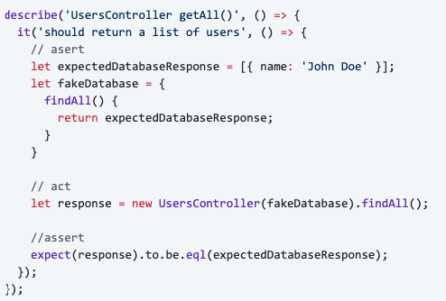
Test Double Types
“have working implementations closer to a real-world implementation”
Fake

Slide 31
Test Double Types
Fake
Stub
Spy
Mock

Slide 32
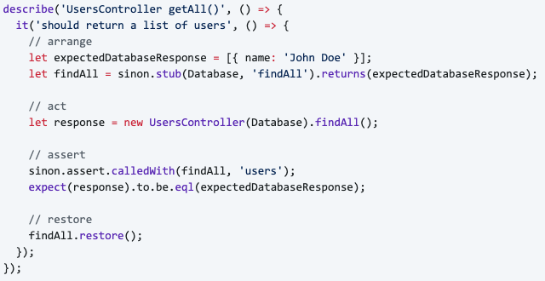
Test Double Types
“provide canned answers to calls made during the test”
Stub

Slide 33
Test Double Types
Fake
Stub
Spy
Mock

Slide 34
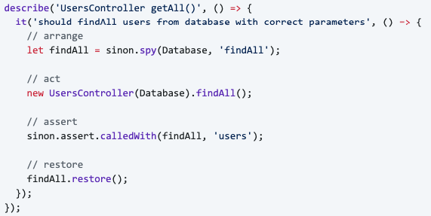
Test Double Types
“are stubs that also record some information based on how they were called”
Spy

Slide 35
Test Double Types
Fake
Stub
Spy
Mock

Slide 36
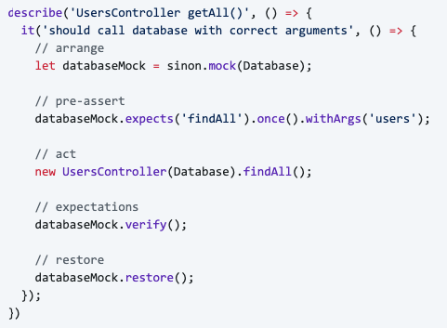
Test Double Types
“has a set of expectations about calls that are made and, if these expectations are not met, the test fails”
Mock

Slide 37
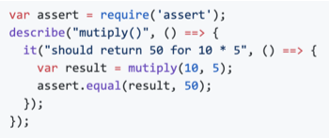
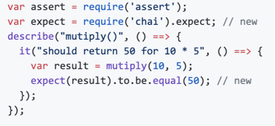
Why using Mocha + Chai + Sinon?
“When we combine them, we have a powerful (mocha + sinon) and quick unit testing framework
on top of node w/ an assertion library which is very easy to understand and to code”
only mocha
mocha + chai

Slide 38
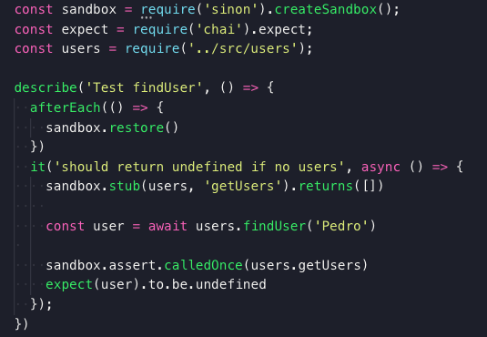
Why using Mocha + Chai + Sinon?
“When we combine them, we have a powerful (mocha + sinon) and quick unit testing framework
on top of node w/ an assertion library which is very easy to understand and to code”
mocha + chai + sinon

Slide 39
Suggestions
Strive for testing observable behavior

Slide 40
Suggestions
Strive for testing observable behavior
instead of:
If I enter x and y…
Will the method call class A first,
then call class B and then return
the result of class A plus the result of class B?
use:
If I enter values x and y,
will the result be z?

Slide 42
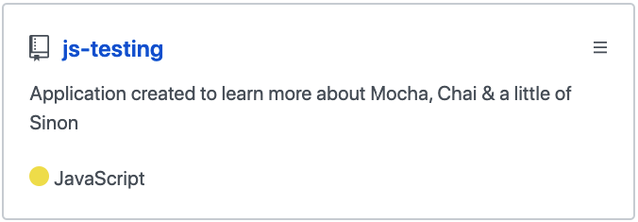
Reference
github.com/LuisValgoi/js-testing

